Slide 1
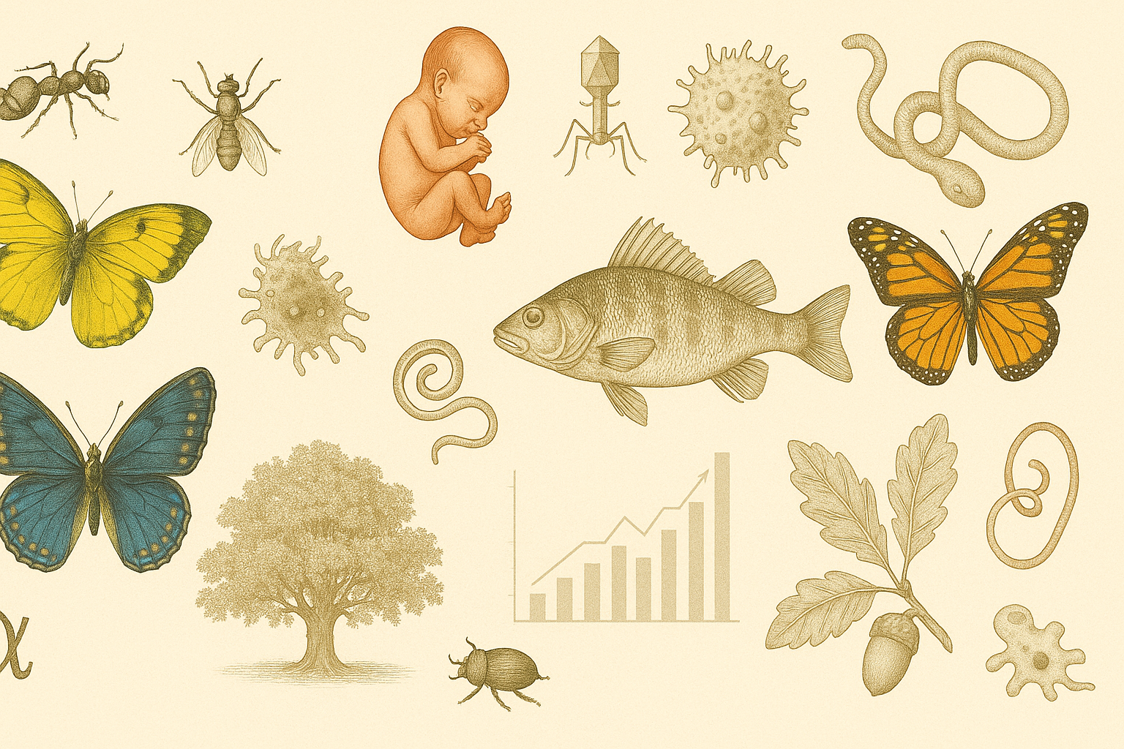
The University of Burdwan
Three/Four-year UG course under NEP
Paper ZOOL1011
Classification of Subkingdom Protozoa
DR. SAGAR ADHURYA
Assistant Professor in Zoology
West Bengal Education Service

Slide 2
Learning Objectives
Understand the general characteristics of subkingdom Protozoa
Learn the classification system proposed by Levine et al. (1980)
Identify the seven phyla and their distinguishing features
Recognize examples of each phylum

Slide 3
Kingdom Protista & Subkingdom Protozoa
Protista re eukaryotic, unicellular, heterotrophic or autotrophic organisms.
The term Protista was first suggested by German scientist Ernst Haeckel in 1866.
The earliest fossils of the protists date back to 1.4 billion years ago, i.e., radiolarians and foraminiferans.
Protozoans are heterotrophic eukaryotic unicellular animals.
The word "protozoa" (singular protozoon) was coined in 1818 by zoologist Georg August Goldfuss.
The term Protozoa is formed from the Greek words πρῶτος (prôtos), meaning "first", and ζῷα (zôia), plural of ζῷον (zôion), meaning "animal".
Found in diverse habitats: freshwater, marine, soil, and as parasites.
About 50,000 known species.

Slide 4
Protozoan classification
Earlier classifications were based mainly on locomotory organelles:
Sarcodina (pseudopodia)
Mastigophora (flagella)
Ciliata (cilia)
Sporozoa (no locomotory organelles).
Later, electron microscopy and molecular biology revealed more complexity.
Basis of Classification (Levine et al., 1980):
Mode of locomotion
Ultrastructural features
Life cycle and reproduction
Widely adopted in zoology curricula for clarity and systematic grouping.

Slide 5
General Characters
Microscopic and unicellular animalcules.
Protoplasmic grade body organisations.
They exhibits all kinds of symmetry
Contains one or more nuclei, which can be monomorphic or dimorphic.
Single or colonial
Body either naked or covered by pellicle or test, made of silica or calcium carbonate.
Locomotory organelles may be flagella, cilia, pseudopodia or absent.

Slide 6
General Characters
Nutrition may be holozoic (animal-like: Amoeba), holophytic (plant-like: Euglena), saprophytic, mixotrophic, and parasitic.
Digestion occurs intracellularly, in food vacuoles.
Respiration and excretion through either body surface or with contractile vacuoles. Contractile vacuoles mainly maintain water balance through osmoregulation.
Reproduction may be sexual or asexual:
Asexual: binary or multiple fission, plasmotomy, or budding.
Sexual: Conjugation and syngamy.
Life history is often complicated by the alternation of sexual and asexual generations.

Slide 7
General Characters
They never develop the blastula stage during development.
Free-living organisms are mostly aquatic, inhabiting fresh and sea waters and dump places. Parasitic and commensal protozoa live over or inside the bodies of animals and plants. Sufficient moisture is essential in their environment.

Slide 8
Classification
Kingdom: Protista
Subkingdom: Protozoa
Phylum 1: Sarcomastigophora
Phylum 2: Labyrinthomorpha
Phylum 3: Apicomplexa
Phylum 4: Microspora
Phylum 5: Ascetospora
Phylum 6: Myxozoa
Phylum 7: Ciliophora

Slide 9
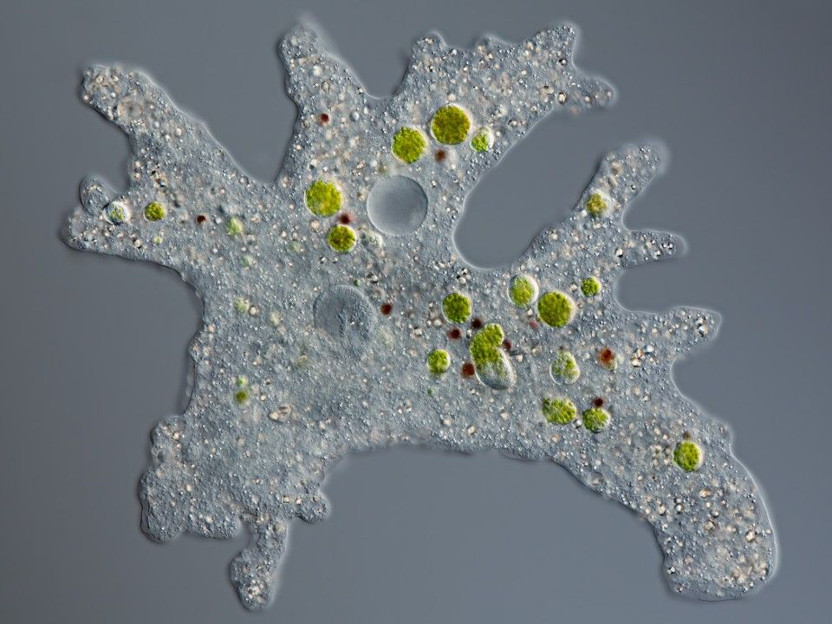
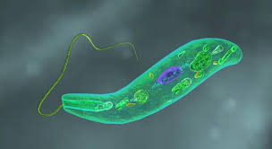
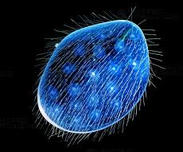
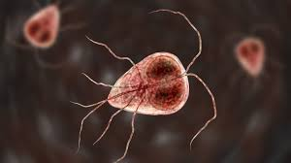
Phylum Sarcomastigophora
Locomotion: Pseudopodia or flagella or both
Nucleus: Monomorphic (single type), except in hererokaryotic Foraminiferida.
Reproduction: Fission (asexual) or syngamy (sexual)
Spore formation: Absent
Amoeba
Euglena
Opalina
Giardia

Slide 10
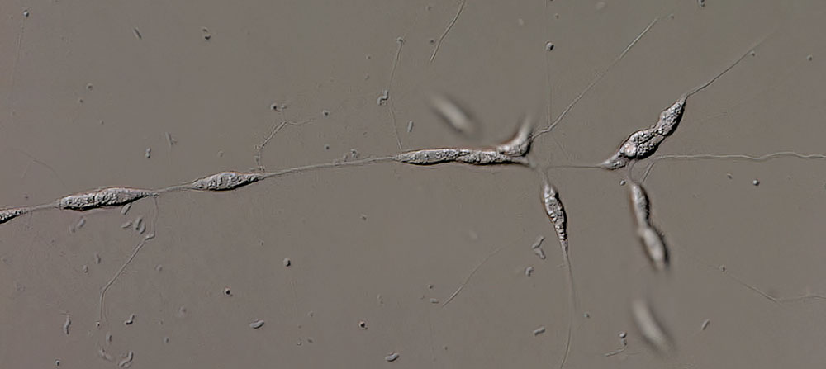
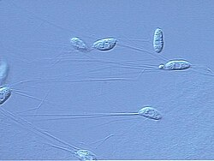
Phylum Labyrinthomorpha
Free-living, found in marine and estuarine water.
Individuals are spindle-shaped and form a net along filamentous tracts.
Ectoplasm reticulate type in the trophic stage. Unique cell surface organelles are associated with the ectoplasmic networks.
Lacks any locomotory organs.
Most species forms zoospores.
Labyrinthula
Aplanochytrium

Slide 11
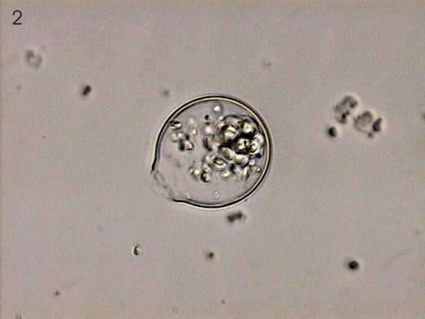
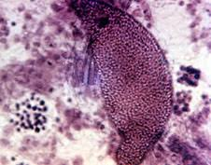
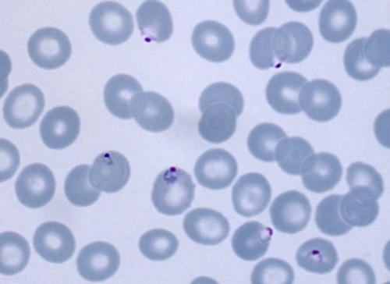
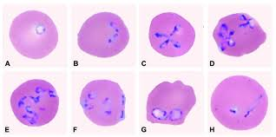
Phylum Apicomplexa
Parasitic
Anterior part of the body forms apical complex, made up of polar rings, rhoptires, micronemes, conoid, and subpellicular microtubules.
Microspores are generally present at some stages.
Absence of cilia but flagellated or amoeboid gametes in some species.
Reproduction asexual or sexual:
Asexual: binary fission
Sexual: gametic (either isogameteous or anisogametous).
Perkinsus
Monocystis
Plasmodium
Bebesia

Slide 12
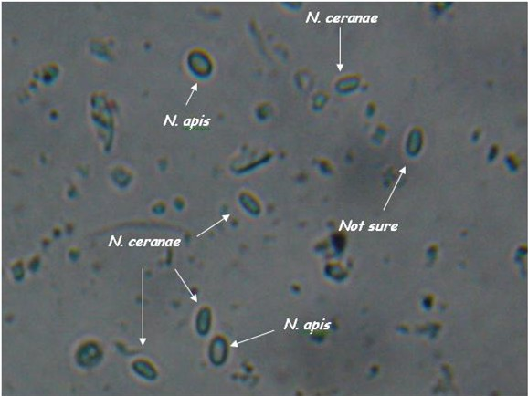
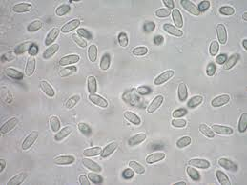
Phylum Microspora
Obligatory intracellular parasites found in nearly all major animal groups.
Spores unicellular, each with an imperforate wall, containing one uninucleate or dinucleate sporoplasm.
Spore is with a simple or complex extrusion apparatus associated with the polar tube and polar cap.
Mitochondria absent.
Usually dimorphic in sporulation sequence.
Nosema
Glugea

Slide 13
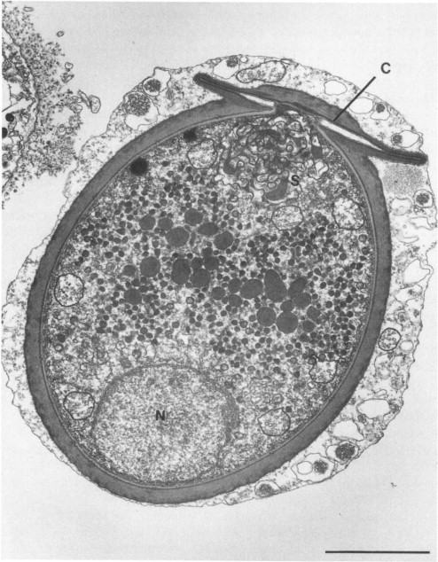
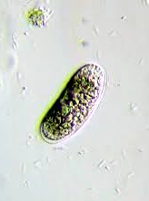
Phylum Ascetospora
Parasitic
Spores are usually multicellular.
Sporoplasm may be one or more
Spores without polar capsules or polar filaments.
Haplosporidium
Enterosporidium

Slide 14
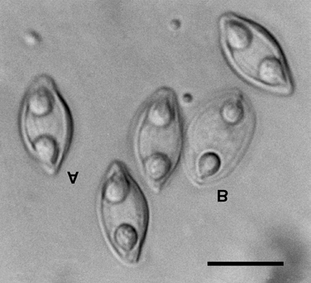
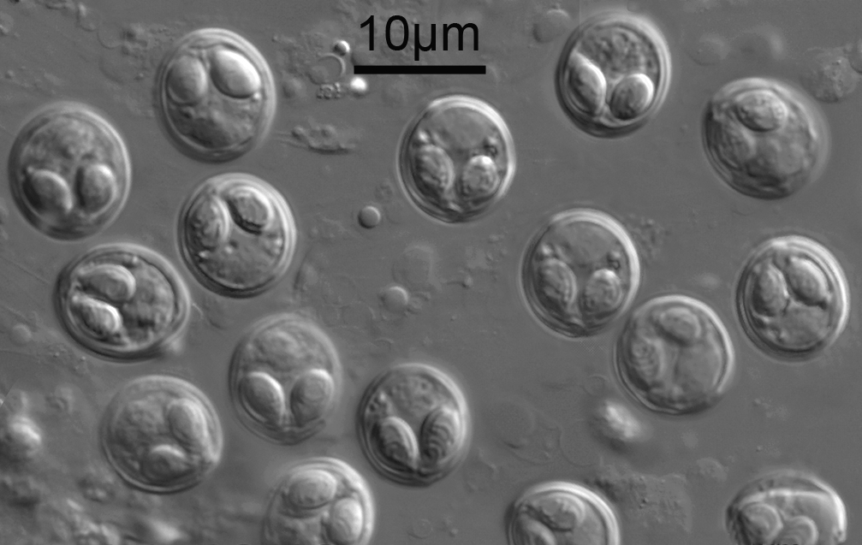
Phylum Myxozoa
Extracellular parasites of annelids and cold-blooded vertebrates (especially fishes).
Polar capsule and sporoplasm one to many.
Spore wall consist of one, two, three or many valves.
Spores are of multicellular in origin.
Remarks: Recent molecular analysis suggests these are not protozoans, rather highly degenerated multicellular animals.
Myxidium
Myxobolus

Slide 15
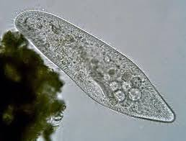
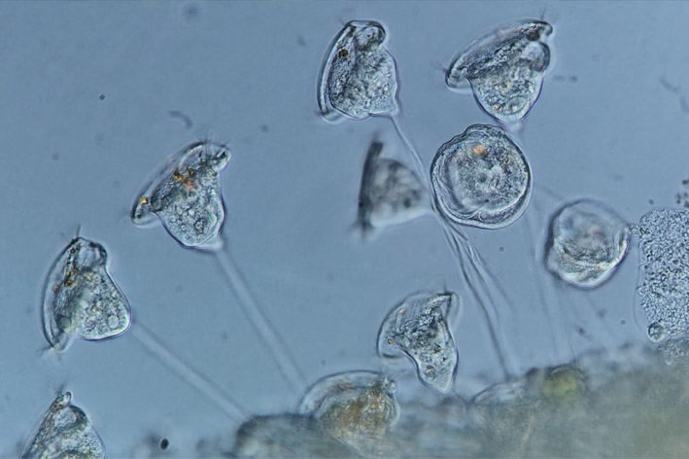
Phylum Ciliophora
Locomotory organelles are simple cilia or compound ciliary organelles, typically at least in one stage of the life cycle.
Subpellicular infraciliature is always present, even during the absence of cilia.
Nucluei bimorphic.
Presence of cytostome and cytopyge.
Nutrition heterotrophic.
Presence of typical contractile vacuoles
Both sexual and asexual reproduction are present:
Asexual: transverse binary fission
Sexual: conjugation, autogamy or cytogamy
Paramoecium
Vorticella

